Slide 1
Modernizing Applications with Containers and Orchestrators

Slide 2
Module 4 - Microservices and Containers
Notes:
Containers are not only for lift and shift scenario.
You can build microservices oriented architecture with containers.
Docker CLI + portability = play a key role in your automation story and your ability to iterate at faster pace.

Slide 4
Objectives
What are Microservices?
Microservices Patterns
Microservices Real World Case Studies
Microsoft Platform and Microservices
Containers & Microservices
Demo
Notes:
Objectives of the discussion:
Define Microservices
Talk about a few good pattern part of this approach
Present few famous case studies where companies used this approach in their journey to the success (you are not Netflix or Amazon but you can be inspired by their story and re-use some of their approach)
Microsoft recommendations to build Microservice architecture (reference application)

Slide 5
Distributed Systems : Fallacies
The network is reliable
Latency isn’t a problem
Bandwidth isn’t a problem
The network is secure
The topology won’t change
The administrator will know what to do
Transport cost isn’t a problem
The network is homogeneous
The system is atomic/monolithic
The system is finished
Business logic can and should be centralized

Slide 6
#1 The Network is Reliable
Hardware, software, security can cause issues
var svc = new MyService();
var result = svc.Process(data);
How do you handle HttpTimeoutException?
Data can get lost when sent over the wire

Slide 7
#1 The Network is Reliable
Solutions:
Retry & Ack / Store & Forward / Transactions
Don’t’ roll your own – too many edge cases
Use reliable messaging infra
MSMQ/ RabbitMQ/ ActiveMQ
But doesn’t provide a request/response synchronous method-centric model

Slide 8
#2 Latency isn’t a Problem (==0)
Time to cross the network is one direction
Small for a LAN, WAN & internet can be large
Many times slower than in-memory access
Bad-old days of OO – remote objects
Even accessing a property was a round-trip
Now we use DTOs
But what about lazy-loading with an ORM?

Slide 9
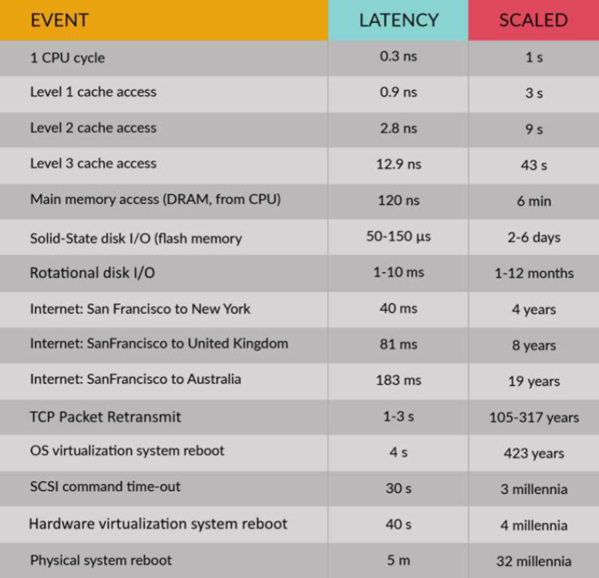

Slide 10
#2 Latency isn’t a Problem (==0)
Solutions:
Don’t cross the network if you don’t have to
Inter-object chit-chat shouldn’t cross the network
If you have to cross the network,
take all the data you might need with you

Slide 11

#3 Bandwidth isn’t a Problem ( )
Although bandwidth keeps growing, the amount of data grow faster
When transferring lots of data in a given period of time, network congestion may interfere
ORMs eagerly fetching too much data

Slide 12
#3 Bandwidth isn’t a Problem ( )
Solutions:
Move time-critical data to separate networks
Can't eagerly fetch everything/ can’t lazy load everything
Might need to have more than one domain model to resolve forces of bandwidth and latency

Slide 13
#4 Network is secure
Unless you’re on a separate network that will never, ever be connected to anything else…
Well, not even then. Viruses, Trojans, etc can still be brought in by users, admins, or even developers
You can't be 100% safe from everythings

Slide 14
#4 Network is secure
Solutions:
Perform a threat model analysis
Balance costs against risks
Most importantly, talk about it. Include PR & Legal department

Slide 15
#6 The Admin will know what to do
Possible in small networks
Until they get run over by a truck promoted
Their replacement probably won't know what to do
If there are multiple admins, rolling out various upgrades and patches, will everything grind to halt?
Will client software be able to work with a new version of the server?
High Availability while upgrading?
Will “continuous deployment” ➔ “Continuous unavaibility”

Slide 16
#6 The Admin will know what to do
Solutions:
Consider how to pinpoint problem in production
Some logging is good, too much can be harmful
Consider multiple versions running in parallel
Although backwards compatibility is hard
Enable the admin to take parts of the system down for maintenance without adversely affecting the rest
Queuing Helps

Slide 17
Is Microservices Good or Bad?
It DEPENDS
😊
Notes:
On what

Slide 18
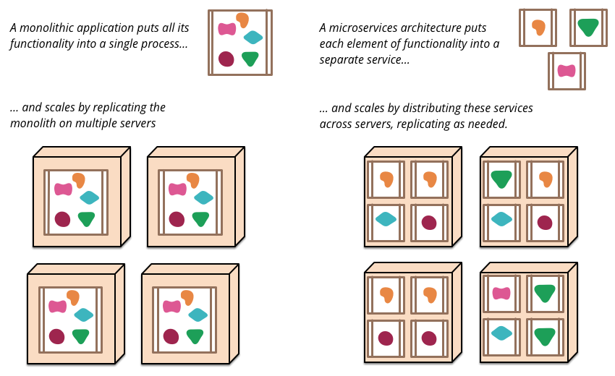
Microservices Architecture
Notes:
Monolithic application → entire app in the same VM
Microservices → application split into independent services scattered across the cluster
To scale out monolithic app → copy entire application to new machine. → Long and unnecessary
In Microservices, you can spin up a new instance of a service on available nodes.
→ Better utilization of your hardware – better reaction in case of traffic spike.

Slide 19
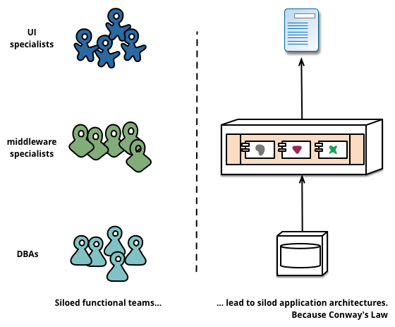
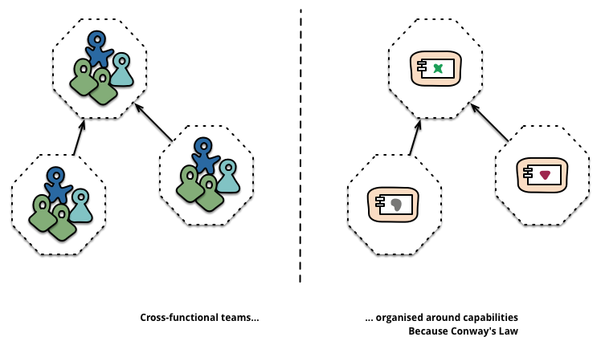
Microservices Architecture (Cont.)
“Any organization that designs a system (defined broadly) will produce a design whose structure is a copy of the organization's communication structure.” -- Melvyn Conway, 1967
Monolithic
Microservices
Notes:
Conway’s Law: System tend to be designed as copies of organization structures (communication).
While Microservices should be designed being focused on business capabilities.
It is usually better when teams are organized in small cross functional teams to produce loosely coupled microservices.
Note: https://www.thoughtworks.com/insights/blog/demystifying-conways-law → open-source teams produce more modular code than big companies organized in big teams

Slide 20
SOA and Microservices
SOA
Services are interfaces of a large monolith
Orchestration is often required and tend to contain business logic
Spans across the enterprise
Microservices
Services are individually developed and deployed
Does not require integration technology, logic resides in microservices
Can be limited to an individual project
Notes:
Service Oriented Architecture vs Microservices
SOA:
In SOA, you expose service interfaces, but you still have a monolith of tightly coupled capabilities.
Usually bigger than Microservices
Rely on nonstandard protocol (SOAP, WCF)
Microservices:
Some people say microservices is SOA done correctly, system is decomposed on a per capability basis
Each component is technology agnostic but relies on its own technology stack and its own storage.
Rely on standard protocols: HTTP, WebSocket, AMQP (messaging)
Services independently developed/deployed/scaled

Slide 21
Microservices Design Patterns

Slide 22
API Gateway
Challenges this pattern solves:
Granularity of services is often more fine grain than what client would need
Different type of clients need different data
Protocol used by services differ greatly. E.g. AMQP, WebSocket etc.
Partitioning of services should be hidden from the clients
Notes:
API Gateway:
Hide complexity and internal protocol ongoing behind the scene. Makes sense if this complexity does not produce any value for the client.
The complexity can come from different protocols used between services => WebSockets or AMQP (asynchronuous queuing mechanism)
It can come from partitioning of data to support more load => has to be abstracted away from clients.

Slide 23
API Gateway
Solution:
API Gateway acts as an entry point for all access to Microservices by encapsulating the internal system design and provides:
API that is tailored for each client
Security features such as authentication, token cache etc.
Protocol transition
Load balancing
Notes:
Solution => API Gateway pattern to centralize this logic.
It can be responsible for cross-cutting concerns:
Routing/Aggregation
Authentication
Caching
Load balancing
A/B testing
Client specific transformation

Slide 24
API Gateway
REST API
Order
REST API
Product
API Gateway
REST API
/orderdetails?orderid=123
Review
Routing
Protocol Translation
Composition
Results Aggregation
REST API
Cart
REST API
Shipping
Notes:
Example of API Gateway for an online store
Get status of an order
Would call Order service
Product service => display the metadata of the products ordered => SQL database
Review
Cart
Shipping
Each service would have its own responsibility and its own data store (single source of truth)

Slide 25
Service Discovery
Challenges this pattern solves:
Services addresses change dynamically due to auto scaling
Discovering services is inheriting more challenging as more services are added
Solution
Discover services dynamically using service registry (database of available services) that will locate the instance of service to call
Client-Side Discovery
Server-Side Discovery
Notes:
Other challenge: know where each service lives in the cluster
Solution: keep track of a mapping serviceId => list of IPs

Slide 26
Client Side Discovery
/ordersrvc
10.1.2.3:6060
Order
#1
/ordersrvc
10.1.2.6:6060
Order
#2
Registry Aware Client (e.g. Mobile App, SPA etc.)
/ordersrvc 10.1.2.6:5050
Order
# 3
/serrviceregistry?srvc=order
Services Registration
/ordersrvc
10.1.2.3:6060
/ordersrvc 10.1.2.7:5050
Order
#4
Service Registry
order| ordersrvc,10.1.2.3:6060
ordersrvc,10.1.2.6:6060
…..
Order
#5
/ordersrvc
10.1.2.8:5050
Notes:
Client-side discovery:
Clients call the service registry and then one of the address returned
Good : performance.
Bad : complexity on client side. If machine goes down between lookup and request, clients have the handle transient failures.

Slide 27
Server Side Discovery
/ordersrvc
10.1.2.3:6060
Order
#1
/ordersrvc
10.1.2.6:6060
call well define end point
/services/order
Order
#2
Client (e.g. Mobile App, SPA etc.) without knowledge of Service Discovery
Router
Client Specific Routing
Load Balancing
/serrviceregistry?srvc=order
/ordersrvc
10.1.2.6:5050
Order
#3
/ordersrvc
10.1.2.3:6060
Services Registration
/ordersrvc
10.1.2.7:5050
Order
#4
Service Registry
order| ordersrvc,10.1.2.3:6060
product |productrvc,10.1.2.6:6060
…..
Order
#5
/ordersrvc
10.1.2.8:5050
Notes:
Generally preferred: Server-side discovery.
The resolution is done server side.
Good : less complexity on client side.
Bad : performance→ extra networking call → intra cluster so it is fast/cached.
Risk of timeout due to resolution overhead

Slide 28
Service Registry Pattern
Service Registry is a key part of service discovery. It is a database containing the network locations of service instances.
A service registry needs to be highly available and up to date.
Clients can cache network locations obtained from the service registry.
Example:
etcd : A highly available, distributed, consistent, key-value store that is used for shared configuration and service discovery. Two notable projects that use etcd are Kubernetes and Cloud Foundry.
Apache ZooKeeper : A widely used, high-performance coordination service for distributed applications. Apache ZooKeeper was originally a subproject of Hadoop, but is now a separate, top-level project.
Notes:
When you need Service Discovery (multiple workload in a cluster of machine), you need a Service Registry component
=> Where mapping serviced -> IPs will be stored.
Need to be reliable, fast, cachable (client side or server side.)
Example:
etcd: used by Kubernetes or Cloud Foundry
Apache ZooKeeper is also popular: originally part of Hadoop. Now its own project.

Slide 29
Self Service Registration
Service instance is responsible for registering and unregistering itself with the service registry. Also, if required, a service instance sends heartbeat requests to prevent its registration from expiring.
/ordersrvc
10.1.2.3:6060
Order
#1
register | ordersrvc,10.1.2.3:6060
send-heartbeat
un-register
Service Registry
Notes:
To build and maintain service registry:
-> self registration.
Services register, sends heartbeat and unregister to keep the Service Registry up to date

Slide 30
3rd Party Registration
/ordersrvc
10.1.2.3:6060
Order
#1
monitoring + health checks
3rd Party Registrar
A 3rd party registrar is responsible for registering and unregistering a service instance with the service registry.
register | ordersrvc,10.1.2.3:6060
send-heartbeat
un-register
Service Registry
Notes:
Or you can rely on a third party component to perform registration, health check and unregistration.

Slide 31
Deployment Patterns
When Deploying Microservices one must consider following:
Each service is independently scalable and deployable
Deployment should be automated, fast and reliable
Service usage of resources (CPU, memory etc.) should be configurable
Scale out by running multiple instances per service
Notes:
Many microservices => many deployments.
They need to be fast, reliable/transparent, automated (CI/CD), independent
You want each service to be independently scalable without side effects (like warm up delay or data loss) => stateless services / pet vs cattle

Slide 32
Microservices Architecture
Build any app in any language using any stack(OS)
Notes:
Bottom line is – each service can be written in its own language, with its own OS, its own storage layer (graph database, SQL, No-SQL)

Slide 33
Multiple Service Instances Per Host
Service instances share same vm (CPU/memory etc.)
Hard to achieve isolation unless every service instance run in a separate process
Closer to traditional hosting models which means less learning curve for operations
Host machines are treated as pets
order
#1
order
#2
order
#3
product
#1
product
#2
product
#3
Host (Physical / VM)
Host (Physical / VM)
Host (Physical / VM)
Notes:
How to deploy your workload?
1 - Multiple services per host: more traditional
Service instances share the same OS, Hardware resources. No isolation out of the box
Each host has all the dependencies/prerequisites => treated as pets (you don’t want to loose them).

Slide 34
Single Service Instance Per Host
Service is isolated
Resource usage and dependencies are contained
Less cost efficient than multiple service instances per host pattern
Not that common due to cost of operations and maintenance reasons
order
#1
product
#1
order
#2
Host (Physical / VM)
Host (Physical / VM)
Host (Physical / VM)
Notes:
To achieve isolation => 1 service per host.
Still all prerequisites need to be installed on the machine => pet approach => not flexible
Bad utilization of the hardware.

Slide 35
Service Instance Per VM
Services are deployed as VM Images
High degree of isolation for service instances as they run on a VM
VM allows for CPU and other resource limitations
Services can use VM based optimizations for faster execution
VM takes more time to start/stop compare to containers
VM takes more storage space than containers
order
#1
order
#3
Product
#2
VM
VM
VM
order
#2
product
#1
product
#3
VM
VM
VM
Physical Host
Physical Host
Physical Host
Notes:
To mitigate utilization problem: 1 service per VM.
Still good isolation but utilization can be improved + pets approach.
It takes time to spin up a new VM

Slide 36
Service Instance Per Container
Services are deployed as Container Image
Containers are magnitude faster than VMs
Allow higher degree of scalability in comparison to VMs
Single VM multiple containers provide cost savings
Containers use less storage and memory than VMs
Containers are state-less by default
Container
Container
Container
Container
order
order
order
order
VM
VM
Container
Container
Container
Container
order
product
product
product
VM
VM
Physical Host
Physical Host
Notes:
An effective solution:
- 1 service per container
Multiple container per VM
Multiple VM per physical host
Faster to spin up new instances
Good VM level + container level isolation
Best HW utilization
Container are cattle. (can be deleted and recreated)

Slide 37
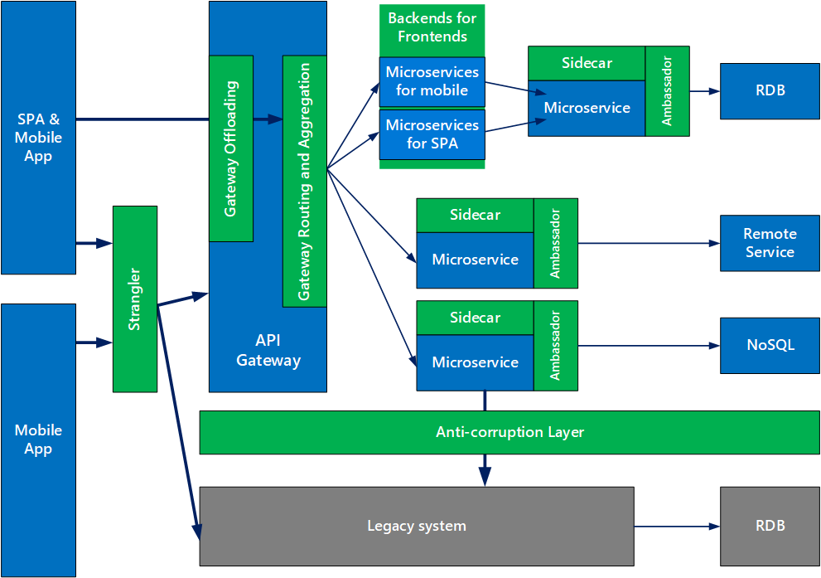
Microservice Design Patterns Relationship
Notes:
List of known pattern: https://docs.microsoft.com/en-us/azure/architecture/patterns/
Some are interesting while working with container:
- Sidecar, Ambassador.
Strangler, Anti-corruption to migrate from legacy system to new system
Gateway pattern

Slide 38
Microservices Design Patterns in Practice

Slide 39

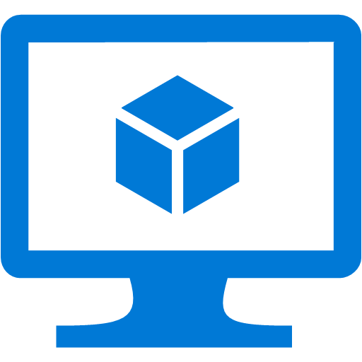
Traditional application approach
Microservices application approach
A traditional application has most of its functionality within a few processes that are componentized with layers and libraries.
Scales by cloning the app on multiple servers/VMs
App 1
A microservice application segregates functionality into separate smaller services.
Scales out by deploying each service independently with multiple instances across servers/VMs
App 1
App 2
Independent deployment and scale of microservices
Coarse-grained density of apps/services
Fine-grained density of services
Need to deploy and scale the full application
Notes:
Deployment models of monolithic vs microservices
Instantiate Services instead of spinning up new machines => faster
Better utilization of hardware
Optimize Cost
Lower time to market: more confident when it comes to upgrading a service
Services are independently:
- Implemented
- Deployed
- Scaled
- Versioned

Slide 40
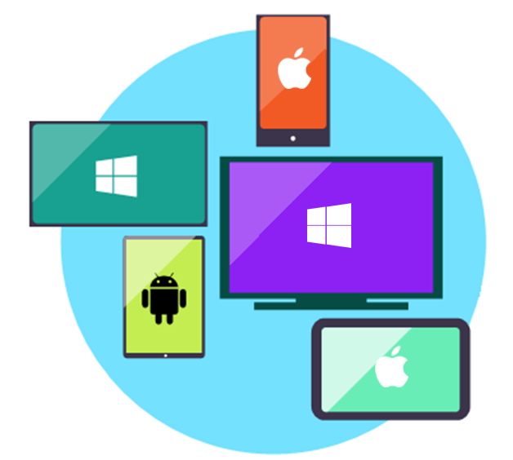
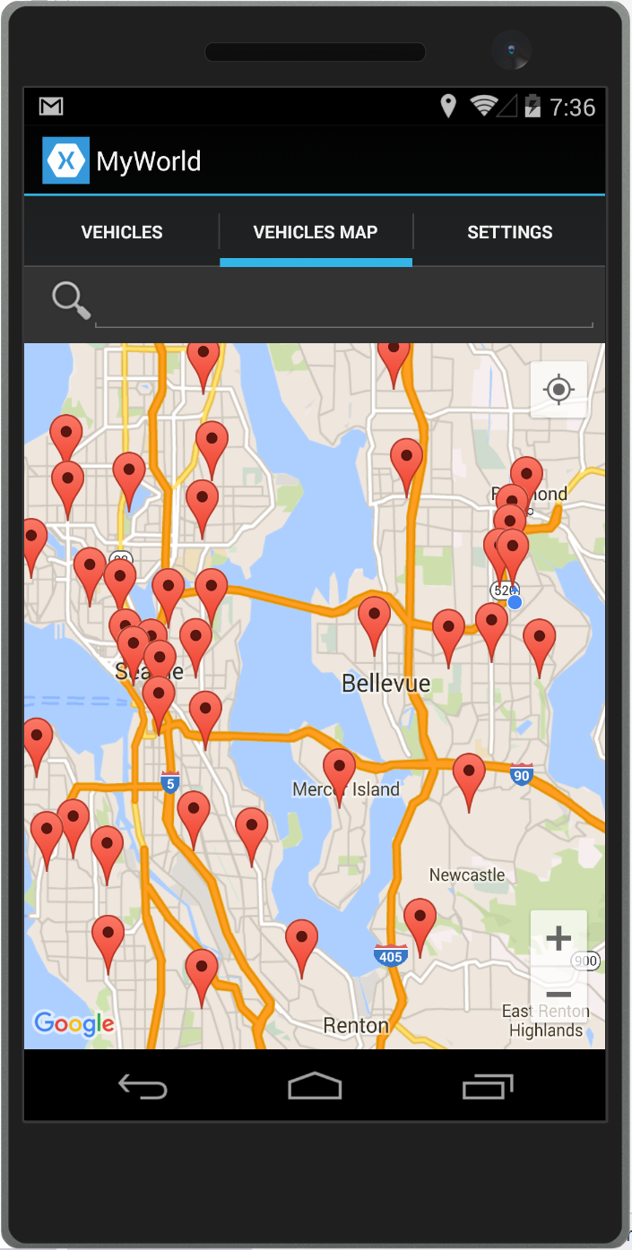
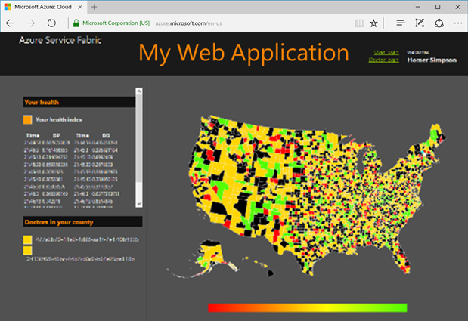

Data in Traditional approach
Data in Microservices approach
Single monolithic database
Tiers of specific technologies
Graph of interconnected microservices
State typically scoped to the microservice
Remote Storage for cold data
Web Tier
Services Tier
Cache doesn’t help much for massive data ingress (Events, IoT, etc.)
Mobile
apps
Web presentation services
Cache Tier
Database servers are usually the bottleneck
Stateless services
SQL DB
or
No-SQL
Stateful services
Data Tier
SQL
[…]
Monolithic Databases are shared across services.
Stateless services
with
separate stores
Each microservice owns its model/data!
Notes:
Left -> Monolithic:
1 front end layer
1 middle tier layer (business logic)
1 data layer with common database
Right -> Microservices
Graph of interconnected service who know how to talk to each other, thanks to service discovery feature
Each of them are stateless but can rely on a persistent data store.
=> Technology agnostic, use whatever database is best for your use case (Graph database, SQL, No-SQL)
The system is decomposed into multiple independent data store
One service = one responsibility
One service = 1 or multiple independent data store

Slide 41
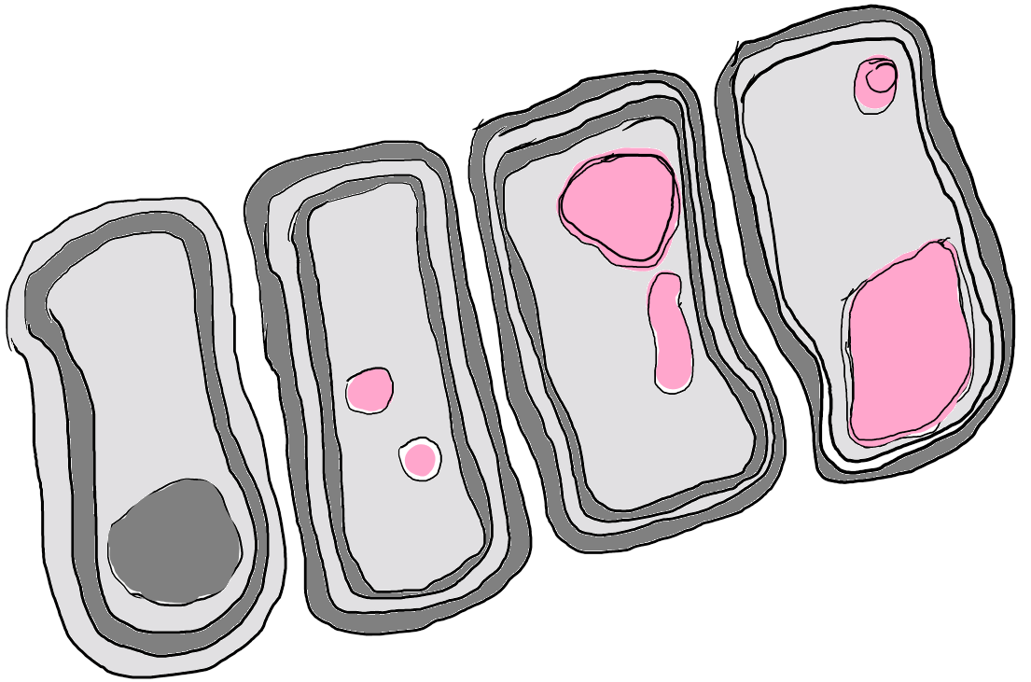
The Bounded Context pattern
Cells
Independent
Autonomous
Loosely coupled composition
“Cells can exist because their membranes define
what is in and out and determine what can pass”
[Eric Evans]
Notes:
Bounded context => Determine what’s inside/outside a service and what can pass (just like cells). Their lifecycle is independent.

Slide 42
Bounded Contexts and Microservices
Bounded Context == “Business Microservice” boundary
Each Bounded Context has:
- Its own Domain Model → i.e. Database
- Its own context, invariants, rules, code!
- IT IS AUTONOMOUS!
Notes:
Bounded context => domain model (data store)
Internal rules, logic => + AUTONOMOUS.

Slide 43
Business/Logical Microservices
(Bounded Contexts)
Example 1
Example 2
Example 3
Catalog “business” microservice
Ordering “business” microservice
Business/logical
microservice
SQL Server database
Ordering.API
Gateway
service
Web API
SQL Server
database
GracePeriod
Stateful service
partitions
Worker Svc.
Partition
A
Partition
n
(Using Azure Service Fabric Stateful Reliable Services)
The Logical Architecture can be different to the Physical/Deployment Architecture
A Bounded Context can be implemented by 1 or more services (i.e. ASP.NET Web API)
Notes:
Bounded Context can be implemented by 1 or multiple services.
Logical vs physical services.
Example 1: 1:1 mapping WebAPI <->database
Example 2: Web API + Worker <-> Database
Example 3 (Service Fabric): Stateless Gateway Service <-> multiple stateful partitions of the same service.

Slide 44
Identifying a Domain-Model per Microservice/BoundedContext
Orders and Registration
Conferences Management
Conferences
Buyers
Organizers
Conferences
Seats
Seats
Attendees
Companies
Country
Orders
Reservation
Users
Attendees
Seats Assignments
Pricing and Marketing
Payment
Customer Service
Conferences
Payers
Customers
Promotions
Payments
Returns
Seats
External Gateways
…
Notes:
Example of bounded contexts:
-> Users represented in multiple microservices.
-> Internally:
- Different names Users, Customer, Payer, Buyer
- Different fields
-> Externally
Ubiquitus language => define a common terminology for cross-services interactions.

Slide 45

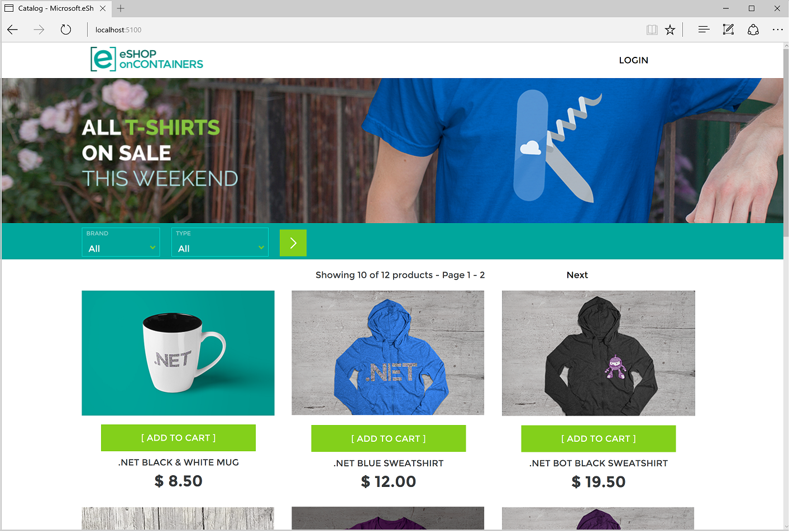
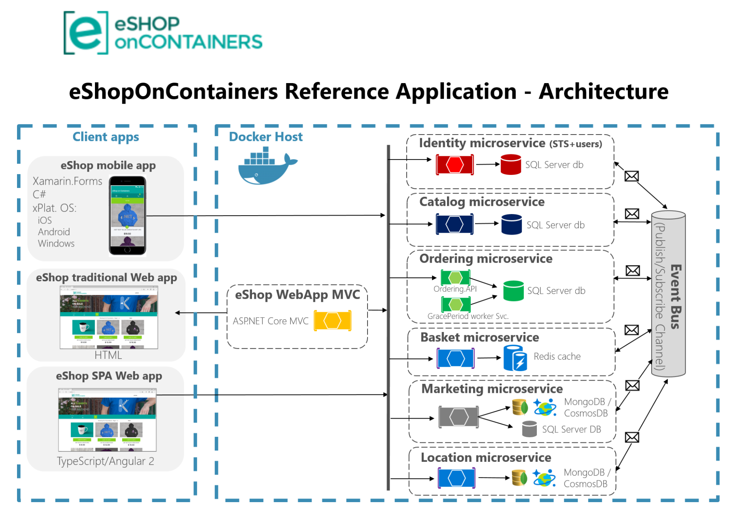
.NET microservice and container guidance
Reference application
aka.ms/MicroservicesArchitecture
Notes:
Reference application published by a group of PM at Microsoft.
Build an online store with microservices and containers.
Hosted in Kubernetes or Service Fabric.
Relying on different data stores:
SQL Server
Redis Cache
Cosmos DB
Messaging Bus

Slide 46

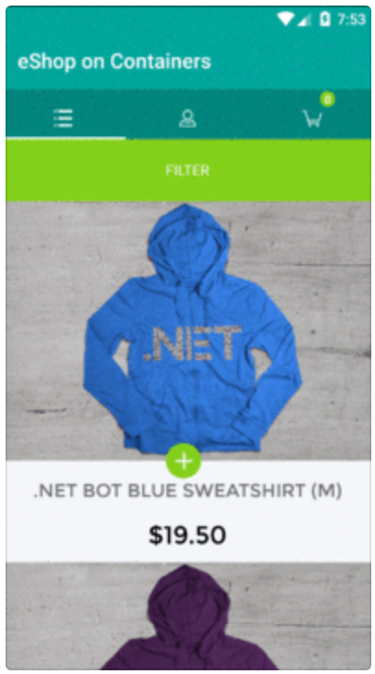
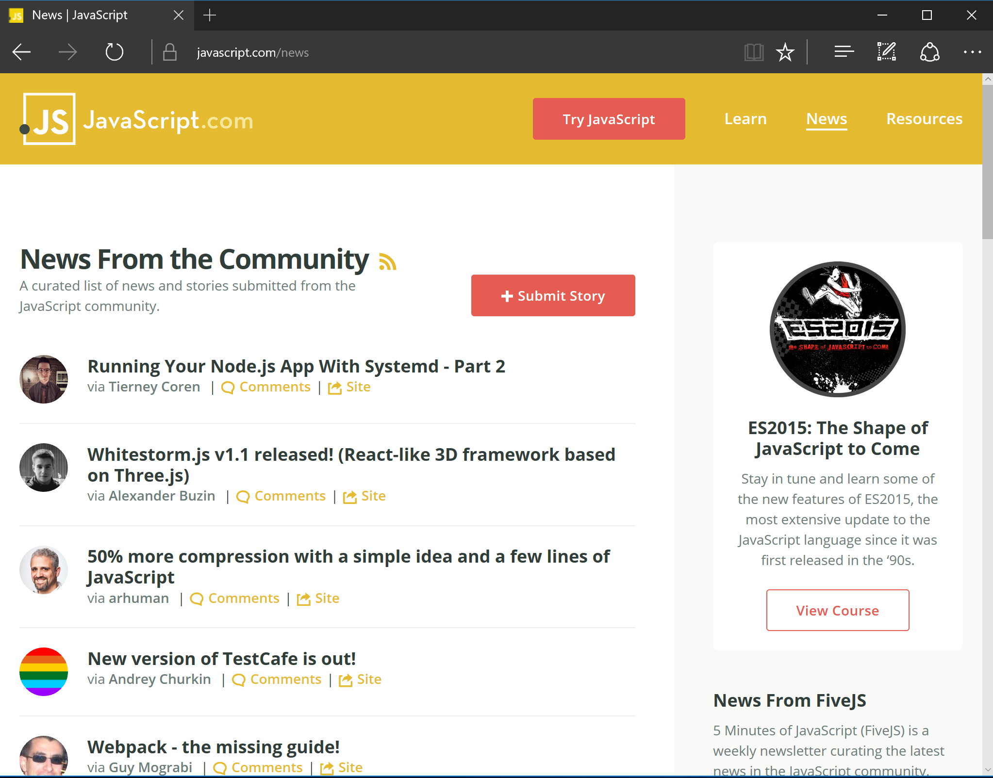
Building resilient cloud applications
Client Mobile App
Back end
With
Retries w/ exponential backoff & Circuit-Breakers
Microservice 1
JSON
Web API
Container
Client SPA WebApp
API Gateway
Microservice 2
ASP.NET Core
Web API
Web API
JSON
HTTP
Container
Container
Request/Response
JavaScript / Angular.js
HTTP
Request/Response
Microservice 3
Web API
Traditional WebApp
Browser
Client WebApp MVC
Container
Implement resilient communication
ASP.NET Core MVC
Container
Implement resilient communication
HTML
HTML

Slide 47
Retries with Exponential Backoff
Back end
Retry 3
Success!
Microservice 1
Web API
Retry 2
Retry 1
API Gateway
Microservice 2
ASP.NET Core
Web API
HTTP
Web API
HTTP
Request/Response
Microservice 3
Web API
Client WebApp MVC
ASP.NET Core MVC
Container

Slide 48
Retries with Exponential Backoff
+ Circuit Breaker
Back end
Retry 4!
Open Circuit!
Microservice 1
Retry 3
Web API
Retry 2
Retry 1
API Gateway
Microservice 2
ASP.NET Core
Web API
HTTP
Web API
HTTP
Request/Response
Respond with
Exception
Microservice 3
Web API
Client WebApp MVC
ASP.NET Core MVC
Container

Slide 49
Risk of Partial Failure Amplified by Microservices
HTTP request/response communication
Backend / Orchestrator
Multiple
Customers
Dependency
1
Dependency
2
Browser
Web App
Dependency
6
Multiple
HTTP requests
Dependency
3
Dependency
5
Submit Order page
Dependency
7
Dependency
4
Dependency
8
Anti-patterns
Notes:
Impact of a single failing service on others can be big.

Slide 50
How to minimize exponential failures in microservices
Circuit-Breakers
Avoid long Http call chains within the same request/response cycle

Slide 51

Synchronous vs. Async communication across Microservices
Anti-pattern
Synchronous
all req./resp. cycle
Client
Http sync.
request
Http sync.
request
Http sync.
request
Http sync.
request
Basket
Ordering
Catalog
Other
Http sync.
response
Http sync.
response
Http sync.
response
Http sync.
response
i.e. MVC app,
API Gateway, etc.
Same Http Request/Response cycle!
Asynchronous
Comm. across internal microservices
(EventBus: i.e. AMPQ)
Client
Http sync.
request
Basket
Ordering
Catalog
Other
Http sync.
response
i.e. MVC app,
API Gateway, etc.
“Asynchronous”
Comm. across internal microservices
(Polling: Http)
Client
Http sync.
request
Http
Polling
Http
Polling
Http
Polling
Basket
Ordering
Catalog
Other
Http sync.
response
i.e. MVC app,
API Gateway, etc.
Http
Polling
Notes:
Multiple data stored = data consistency challenge
Control the depth of your call stack
Prefer asynchronous event propagation:
Asynchronous polling mechanism
Messaging bus (better)

Slide 52

Asynchronous Event-Driven communication with an Event Bus
Backend
Basket Microservice
Database as
Cache
User-Profile Microservice
Service
1
Web API Service
3
UserUpdated event → Buyer info
UpdateUser
command
Event Bus
(Publish/Subscribe Channel)
UserUpdated event
(Publish Action)
4
2
UserUpdated event → Buyer info
DB update
Event Bus Abstractions/Interface
Ordering Microservice
Database
Event Bus Implementations
Azure
Service
Bus
Other:
NServiceBus
MassTransit
etc.
Database
RabbitMQ
Service
Eventual consistency across microservices’ data based on event-driven async communication
Notes:
Reference application => example of implementation
Buyer info published by user profile
Propagated to basket and ordering.
Solutions like RabbitMQ, Azure Service Bus, …

Slide 53
API Gateway
API Gateway
Microservice 1
Calls aggregation
Consumer A
Microservice 2
Who is consuming our services?
Who was consuming what?
Consumer B
What rate?
What time?
Microservice 3
Notes:
Reminder: API Gateway
Aggregate calls to multiple services
Enforce consumer Access right
Do throttling

Slide 54
Using a custom API Gateway Service
Client mobile app
Back end
Microservice 1
JSON
Web API
container
Client SPA Web app
API Gateway
Microservice 2
ASP.NET Core
Web API
Web API
JSON
container
container
JavaScript/Angular.js
Microservice 3
Web API
Traditional Web app
Browser
Client WebApp MVC
container
HTML
ASP.NET Core MVC
container
HTML
Notes:
Write your own API Gateway

Slide 55



API Gateway “as a service/product”
Third parties
KONG
AZURE API MANAGEMENT
Notes:
Or Buy API Gateway solution.
You can quickly show the developer portal experience from API Management:
Go to https://azure.microsoft.com/en-us/services/cognitive-services/text-analytics/
Call out API capabilities
Click on API
Click on Sentiment API
East US
Show documentation + sample + testing of the API

Slide 56



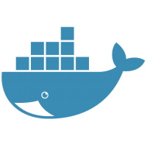

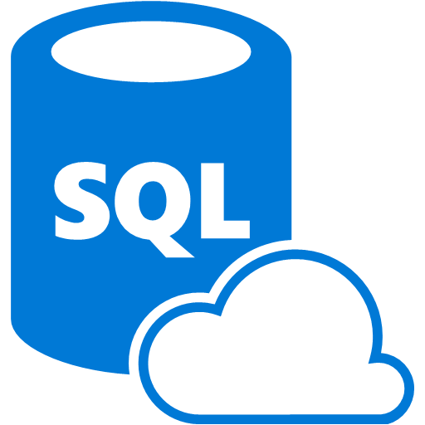



Dev environment
Production environment
Forks/Flavors
eShopOnServiceFabric, eShopOnKubernetes
eShopOnSwarm , eShopOnDCOS, etc.
Foundational
Development technologies
Cloud infrastructure and
Specific Orchestrators
Azure Container Service
.NET Core
.NET Framework
Mesos DC/OS
Kubernetes
Docker Swarm
Development
Orchestrators
+
Azure Service Fabric
Service Bus
SQL Database
Linux Containers
Windows Containers
Other Cloud
Infrastructure
Deployment
BLOB Storage
Cosmos DB
Redis Cache
Key Vault
Exploring Microservices
Architecture/Design/Development
Infrastructure
Decisions
Production-Ready Microservices
Notes:
In the reference architecture:
Programming model: .NET Core, .NET
Packaged in Linux and Windows Containers
Hosting solutions: Kubernetes, Service Fabric
Storage solutions: Service Bus, Azure SQL Server, Cosmos DB, Key Vault

Slide 57
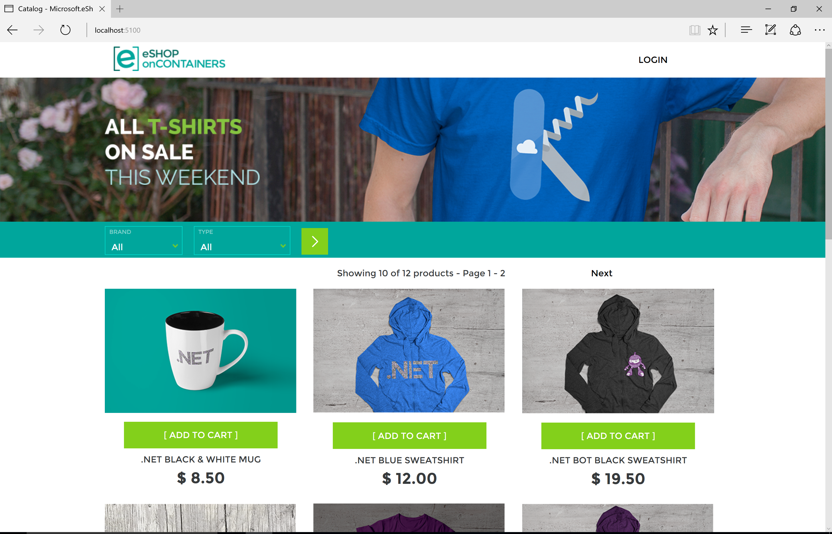
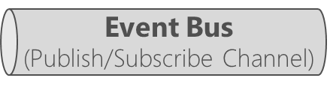
Scaling out eShopOncontainers
Event bus
(Publish/Subscribe channel)
Client apps
Docker Host
Identity microservice (STS+users)
eShop mobile app
Web API
Xamarin.Forms
C#
xPlat. OS:
iOS
Android
Windows
SQL Server
database
container
Catalog microservice
Web API
SQL Server
database
eShop traditional Web app
eShop WebApp MVC
container
ASP.NET Core MVC
Ordering microservice
Container
Web API
HTML
SQL Server
database
eShop SPA Web app
container
Basket microservice
Web API
Redis cache
TypeScript/Angular 2
container
Notes:
Scale out independently each services => number of service instance or number of underlying VMs.

Slide 58
Microservices Real World Case Studies

Slide 59
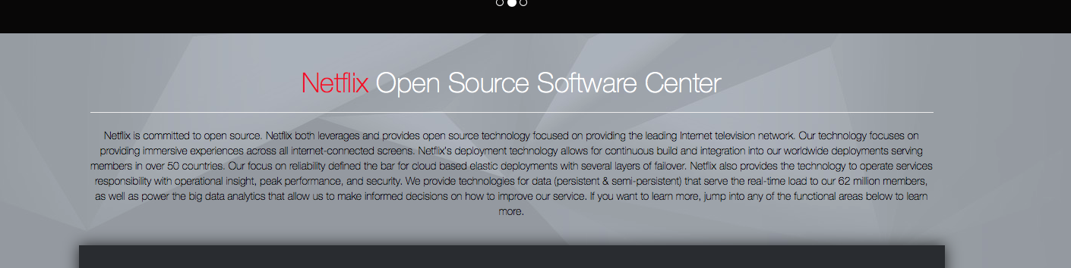
Microservices - A Case Study
https://netflix.github.io
http://tinyurl.com/NetflixMicroservices
Notes:
Started in 2008: 100 engineers producing a monolithic DVD‑rental application. Now they do live streaming primarily
They do A/B testing for their UI and algo.
They deploy new features very quickly => velocity is their core competence.
To move from monolith on-prem to MSA in the cloud, it took 7 years.
Now they’re running 500+ microservices.
Note: They OSSed their components as Hystrix.

Slide 60

Microservices - A Case Study
http://tinyurl.com/SoundCloudMicroservices
Notes:
SoundsCloud journey to a microservices oriented architecture.
From the Mothership monolith used to MSA
From hundreds of thousands of artists to share their work
Now 12 hours of music uploaded every minutes => hundreds of millions of people use their app every day.
Explanation of their strategy and mistakes: share databases between monolith and new microservices.
How they came up with their Event Sourcing approach.

Slide 61
Microservices - A Case Study
http://tinyurl.com/NginxMicroservices
Notes:
On this link from the Nginx website – great explanations of the microservices approach, different pattern and challenges solved using it.

Slide 62
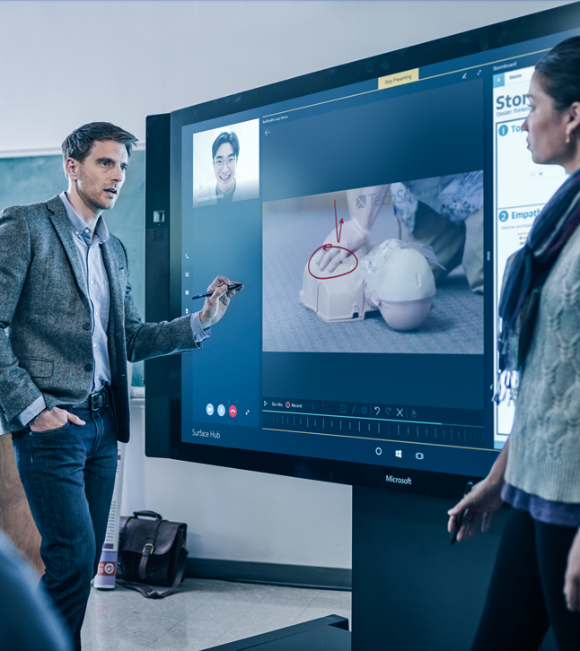
Demonstration: Building Microservices with Containers
eShopOnContainers
Notes:
Please review the code available inside /demos/module4/_eShopOnContainers
For comprehensive documentation please review the project wiki: https://github.com/dotnet-architecture/eShopOnContainers/wiki

